Slide 1
Wifi-6
IEEE 802.11ax
Full course at https://telcomaglobal.com
TELCOMA

Slide 2
Introduction

Slide 3
History
The popular wireless LAN technology is Wi-Fi.
The broadband wireless connectivity is provided by it to fixed, portable and moving users in the unlicensed and 2.4/5 GHz frequency bands.
The acceptance is rapidly gained by this technology as an alternative to a wired local area network since its deployment is much easier and more cost- efficient.
(contd...)

Slide 4
History
It becomes an everyday necessity of accessing data wirelessly for for both consumers’ enterprises.
The entire industries, fueling growth, productivity and profits has been transformed due to unfettered access to information in the last 30 years.
A key role in this transformation has been played by the Wi-Fi technology governed by IEEE 802.11 standard that provides pervasive, low cost access to high data rate wireless connectivity to the users.
(contd...)

Slide 5
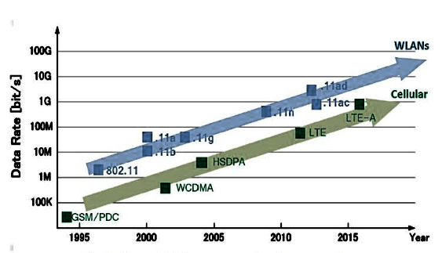
History
The figure shows the evolution of protocols of wireless communication.

Slide 6
History
In 2014, there was a formation of new group named HEWG (High Efficiency Working Group) for creating new mechanisms and amendments to IEEE 802.11, which aims to develop the new standard.
(contd...)

Slide 7
Introduction
The next fast-approaching IEEE standard is 802.11ax by which today’s biggest Wi-Fi challenges such as high density and performance can be addressed.
To address this challenge, its capacity has been increased by up to four times and spectral efficiency has been improved for benefiting both 2.4 gigahertz (GHz) and 5 GHz bands in a variety of environments.
(contd...)

Slide 8
Introduction
The client density will be handled by 802.11ax more efficiently through a new channel-sharing capability, negotiated wake-time scheduling between APs and clients is used to improve the battery life to preserve energy, and efficiency improvements are delivered with at least four times more throughput than 802.11ac.
(contd...)

Slide 9
Wi-Fi Challenges
There has been an evolution of Wi-Fi with each new protocol since the commercial release of the original 802.11 wireless networking standard and achieving successively higher peak speeds theoretically.
However, the speed of Wi-Fi is not the major problem in the real world but the capacity of the network to handle the expanding population of client devices as well as numerous users with diverse networking needs.
(contd...)

Slide 10
Wi-Fi Challenges
The Wi-Fi network may be designed in such a way that the growing demand for the high volume and diversity of connected devices and services can be addressed and measured on the basis of the user experience.
(contd...)

Slide 11
The 802.11ax Vision
High efficiency
High throughput
Improves capacity
Provides better coverage
Reduces congestion
Improves spectral efficiency
(contd...)

Slide 12
The 802.11ax Goals
Enhancement in the operation in the 2.4 GHz and 5 GHz band
Increase in average throughput per station by at least four times in dense deployment scenarios
Enhancement in both indoor and outdoor environments
Maintenance or improvement of power efficiency in stations
Improvement of the traffic management efficiency in a variety of environments
(contd...)

Slide 13
The Enhancement Components of 802.11ax
Uplink and downlink (UL/DL) orthogonal frequency-division multiple access (OFDMA)
Longer orthogonal frequency-domain multiplexing (OFDM) symbol
UL/DL 8×8 multi-user multiple-input multiple-output (MU-MIMO)
Spatial reuse
Power saving using Target Wake Time (TWT)
1024 quadrature amplitude modulation
(contd...)

Slide 14
The Enhancement Components of 802.11ax
New PHY headers
Enhancement in the outdoor robustness
Support for 5 GHz and 2.4 GHz
(contd...)

Slide 15
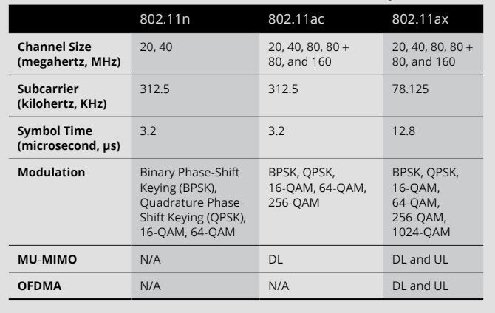
Comparison of 802.11ax, 802.11ac, and 802.11n

Slide 16
Wi-Fi Use Cases
For development of early 802.11ax standard, the primary use case of Wi-Fi was for high-density network environments like large public venues.
High-density means twenty or more devices to provide an acceptable level of service to all users on the Wi-Fi network of the enterprise.
It is challenging for today’s enterprises to deal with corporate-owned wireless devices, employee devices, guest devices, wireless security cameras, environmental sensors, and more.
(contd...)

Slide 17
Wi-Fi Use Cases
Due to the potential of IoT of providing wireless access for almost everything, the complexity of these challenges has been increased.
There are numerous Wi-Fi devices even within a private home that includes voice-activated smart speakers, laptops, tablets, smart-phones, etc.
Therefore, the home becomes a Wi-Fi hive of activity with all these connected devices.
(contd...)

Slide 18
Wi-Fi Use Cases
The another key use case for newer Wi-Fi technologies is the increase in the volume of streaming video.
The parity must be maintained by the Wi-Fi standards with the rapidly evolving 5G cellular standard so that they remain viable users alternative to cellular networks.
The streaming video is time-bounded in addition to dealing with the large data objects of the video i.e. the latency must be kept low.
(contd...)

Slide 19
Wi-Fi Use Cases
The dreaded buffering message, or worse has been resulted by the delays in transmissions caused by the network congestion or retransmissions required by problems with prevailing radio conditions.
Between 2 and 20 Mbps is required by the most of the high-definition (HD) video traffic because video can be highly compressed during transmission.
A bigger challenge is represented by the 4k video as Ultra HD Blu-Ray runs at about 82 to 128 Mbps.
(contd...)

Slide 20
Wi-Fi Use Cases
Handling the growth of the WLAN will be becoming the biggest challenge with gigabits of performance instantaneously available on each Wi-Fi channel.
In order to address the aggregate demand, there is a need of providing as much throughput and efficiency as possible.
It is also expected that the largest market segment in wireless mesh networks is represented by the 2.4 GHz devices through 2022.
(contd...)

Slide 21
Wi-Fi Use Cases
A new Wi-Fi standard is needed to support the expected growth of 2.4 GHz devices, as well as backward compatibility with 802.11n and older Wi-Fi devices should be provided.
(contd...)

Slide 22
Thanks

Slide 23
802.11ax Key Technologies

Slide 24
Multi-User (MU) Defined
802.11ax applies MU to multiple technologies.
MU means that there are simultaneous transmissions between an access point (AP) and multiple Wi-Fi clients that depends on the supported technology.
The use of multi-user orthogonal frequency division multiple access (MU-OFDMA) and multi-user multiple-input multiple-output (MU-MIMO) technologies are defined by 802.11ax.
(contd...)

Slide 25
Multi-User (MU) Defined
802.11ax has the most important new capability named as orthogonal frequency division multiple access (OFDMA) that simultaneously serves the multiple users with varying bandwidth.
802.11ax radios also support OFDM for backward compatibility.
In OFDMA, a Wi-Fi channel is subdivided into smaller frequency allocations known as resource units (RUs) that will enable an access point (AP) so that communication can be synchronized with multiple individual clients assigned to specific RUs.
(contd...)

Slide 26
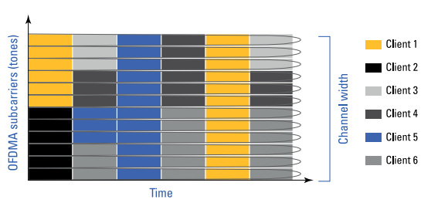
Multi-User (MU) Defined
There can be a simultaneous transmission of small frames to multiple users in parallel as shown in the figure.
The excessive overhead at the medium access control (MAC) sublayer has been cut down due to the simultaneous transmission.

Slide 27
Multi-User (MU) Defined
The whole channel has been allocated by the AP to a single user or it has been partitioned to simultaneously serve the multiple users on the basis of needs of client traffic.
OFDMA results in better frequency reuse, reduced latency, and increased efficiency.
(contd...)

Slide 28
Multi-User (MU) Defined
Subcarriers
In OFDM, a channel is divided into subcarriers through an Inverse Fast Fourier Transform (IFFT).
There is an orthogonal spacing between the subcarriers so that they do not interfere with each other despite the lack of guard bands between them.
(contd...)

Slide 29
Multi-User (MU) Defined
Due to this, signal nulls are created in the adjacent subcarrier frequencies due to which intercarrier interference (ICI) can be prevented.
64 312.5 kHz subcarriers are consisted in the 20 MHz 802.11n/ac OFDM channel.
A longer OFDM symbol time is introduced in 802.11ax of length 12.8 microseconds, which is four times the legacy symbol time of 3.2 microseconds.
(contd...)

Slide 30
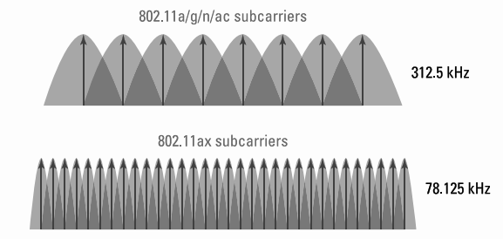
Multi-User (MU) Defined
There is a decrease in the size and spacing of the subcarriers from 312.5 kHz to 78.125 kHz due to the longer symbol time as shown in the figure.

Slide 31
Multi-User (MU) Defined
The better equalization and enhanced channel robustness is allowed due to the narrower subcarrier spacing.
A total of 256 subcarriers are consisted in an OFDMA 20 MHz channel because of the 78.125 kHz spacing.
Subcarriers are of three types for 802.11ax:
Data subcarriers
Pilot subcarriers
Unused subcarriers
(contd...)

Slide 32
Multi-User (MU) Defined
Resource Units (RUs)
When an AP of 802.11n/ac transmits on an OFDM channel to 802.11n/ac clients, each independent downlink transmission uses the entire frequency space of the channel.
Each independent transmission uses all subcarriers when using a 20 MHz OFDM channel.
The entire 20 MHz OFDM channel is needed for the client transmission to the AP.
(contd...)

Slide 33
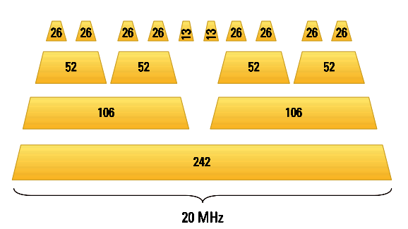
Multi-User (MU) Defined
A total of 256 subcarriers are consisted in an OFDMA channel as shown in the figure.
There is a grouping of these subcarriers into smaller subchannels know as resource units (RUs).

Slide 34
Multi-User (MU) Defined
26, 52, 106, and 242 subcarrier RUs are designated to an 802.11ax AP when 20 MHz channel is subdivided, which roughly equates to 2 MHz, 4 MHz, 8 MHz, and 20 MHz channels, respectively.
The 802.11ax AP dictates the number of RUs used within a 20 MHz channel and use different combinations.
The whole channel may be allocated by AP to only one client at a time or multiple clients are served simultaneously by partitioning the channel.
(contd...)

Slide 35
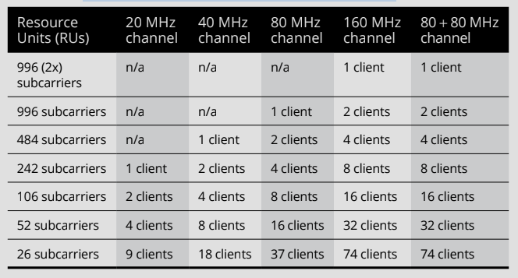
Multi-User (MU) Defined
Resource Units and Wide Channels

Slide 36
Multi-User (MU) Defined
Downlink can be transmitted by 802.11ax APs to multiple 802.11ax clients as well as simultaneous uplink transmissions are synchronized from multiple 802.11ax clients.
The necessary frame exchanges are brought by using the trigger frames in both cases for multi-user communications.
The query of 802.11ax clients about buffered data and the quality of service (QoS) is performed using trigger frames.
(contd...)

Slide 37
Multi-User (MU) Defined
802.11ax clients respond with buffer status reports so that the AP can be assisted to allocate RUSs for synchronized uplink transmissions.
(contd...)

Slide 38
802.11ax Key Technologies I

Slide 39
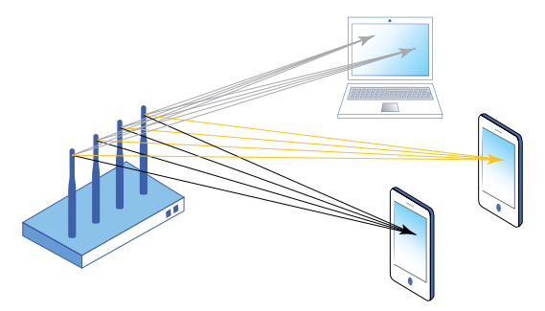
MU-MIMO
The multiple frames are to be transmitted to different receivers at the same time and on the same channel by multi-user, multiple-input multiple-output (MU-MIMO) technology using multiple spatial streams to provide greater efficiency as shown in the figure.

Slide 40
MU-MIMO
MU-MIMO simultaneously transmits unique modulated data streams to multiple clients and hence providing spatial multiplexing.
Only downlink (DL) MU-MIMO is defined in 802.11ac but is not widely implemented for the following reasons:
Very few MU-MIMO-capable 802.11ac clients
Sizable physical distance required
Transmit beamforming (Tx BF) required
(contd...)

Slide 41
MU-MIMO
Some significant MU-MIMO enhancements have proposed in the 802.11ax to address these issues such as grouping sounding frames, data frames, and other frames among multiple users so that overhead can be reduced and uplink response can be increased.
802.11ax clients can be signalled by using the trigger frames so that they participate in uplink MU-MIMO communications.
A key difference between 802.11ac MU-MIMO and 802.11ax MU-MIMO is the number of MU-MIMO clients communicate with an AP at the same time.
(contd...)

Slide 42
MU-MIMO
802.11ac is limited to a MU-MIMO group of only four clients.
Up to 8x8x8 MU-MIMO are supported by 802.11ax in both downlink and uplink and therefore, up to eight users are simultaneously served by it and higher data throughput has been provided.
The minimum RU size for MU-MIMO for both downlink and uplink is 106 subcarriers or greater.
Both MU-OFDMA and MU-MIMO are used simultaneously used.
(contd...)

Slide 43
MU-MIMO
Comparison between MU-OFDMA and MU-MIMO.

Slide 44
Spatial Reuse (BSS Coloring)
Radio frequency (RF) communication is used by Wi-Fi which is a half duplex medium.
Wi-Fi networks use Carrier sense with multiple access collision avoidance (CSMA/CA) method to ensure that only one radio can transmit on the same channel at any given time.
(contd...)

Slide 45
Spatial Reuse (BSS Coloring)
An 802.11 radio will defer transmissions if it hears the physical (PHY) preamble transmissions of any other 802.11 radio at a signal detect (SD) threshold of four decibels (dB) or greater.
A lot of the available bandwidth is consumed by CSMA/CA which is known as contention overhead
(contd...)

Slide 46
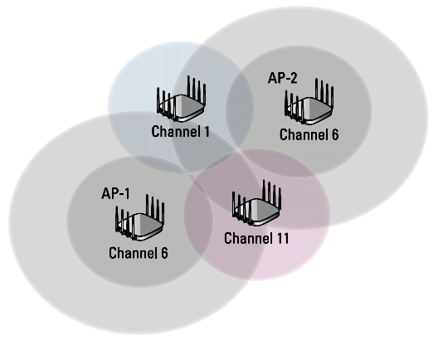
Spatial Reuse (BSS Coloring)
When too many APs and clients hear each other on the same channel, an unnecessary medium contention overhead may occur which is called an overlapping basic service set (OBSS), also referred to as co-channel interference (CCI) as shown in the figure.

Slide 47
Spatial Reuse (BSS Coloring)
The primary cause of OBSS interference are the Wi-Fi clients as shown in the figure.

Slide 48
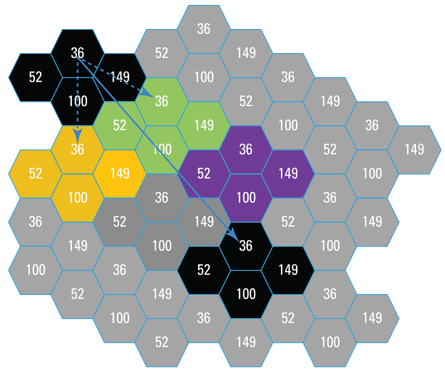
Spatial Reuse (BSS Coloring)
The improvement in the spatial reuse will address the OBSS challenge which is known as BSS coloring.
BSS coloring is a mechanism that is used to address medium contention overhead due to OBSS with assignment of different color to each BSS as shown in the figure.

Slide 49
Spatial Reuse (BSS Coloring)
A color bit is detected by BSS coloring in the PHY header of an 802.11ax frame transmission.
This means that legacy 802.11a/b/g/n clients will be unable to interpret the color bits as they are using a different PHY header format.
Channel access is dependent on the color detected.
The carrier sense operation can be adjusted by 802.11ax radios on the basis of the color of the BSS so that spatial reuse efficiency and performance can be improved.
(contd...)

Slide 50
Spatial Reuse (BSS Coloring)
The different sensitivity thresholds can be used by the station to transmit or defer depending on the BSS from which the traffic is generated.
Therefore, results in higher overall performance.
The SD threshold for inter-BSS frames can be raised by using adaptive clear channel assessment (CCA) while maintaining a lower threshold for intra-BSS frames.
BSS coloring can thus potentially decrease the channel contention problem.
(contd...)

Slide 51
Thanks

Slide 52
802.11ax Enhancements and Design Considerations I

Slide 53
Target Wake Time (TWT)
A power-saving mechanism originally defined in the 802.11ah-2016 amendment.
On the basis of expected traffic activity between the access point (AP) and Wi-Fi clients, TWT is a negotiated agreement, so that a scheduled target wake-up time is specified for clients in power-save (PS) mode.
(contd...)

Slide 54
Target Wake Time (TWT)
An AP is allowed by the negotiated TWTs in addition to the power-saving benefits in order to manage client activity by scheduling client stations to operate at different times and therefore contention between the clients can be minimized.
The required amount of time can be reduced by a TWT that a client in PS mode needs to be awake.
Thus the client sleeps longer and energy consumption can be reduced.
(contd...)

Slide 55
Target Wake Time (TWT)
TWT could allow client devices to sleep for hours that opposed legacy client power-saving mechanisms, which require sleeping client devices to wake-up in microsecond intervals.
For mobile devices and Internet of Things (IoT) devices, TWT is thus an ideal power-saving method so that battery life can be conserved.
A scheduled TWT can be negotiated by setting up TWT frames which are used between the AP and the client.
(contd...)

Slide 56
Target Wake Time (TWT)
For different types of application traffic, as many as 8 separate negotiated scheduled wake-up agreements are there for each 802.11ax client.
TWT functionality is extended in 802.11ax to include a non-negotiated TWT capability.
The wake-up schedules are created by an AP and TWT values are delivered to the 802.11ax clients via a broadcast TWT procedure.
(contd...)

Slide 57
1024-QAM
Better efficiency is the primary goal of 802.11ax.
both the phase and amplitude of an RF signal are used by Quadrature amplitude modulation (QAM) to represent data bits.
1024-QAM and new modulation and coding schemes (MCSs) will be supported by 802.11ax in which higher data rates are defined.
802.11ac introduced 256-QAM modulates 8 bits per symbol, whereas 1024-QAM modulates 10 bits per symbol.
(contd...)

Slide 58
1024-QAM
A more efficient packaging of data is used to achieve this throughput for the same spectrum.
Two new MCSs are also introduced in 802.11ax:
MCS-10
MCS-11
1024-QAM can only be used with 242-subcarrier resource units (RUs) or larger.
(contd...)

Slide 59
1024-QAM
This means that 1024-QAM will need at least a full 20 MHz channel.
Very high signal-to-noise ratio (SNR) thresholds will be needed so that 1024-QAM modulation has been used by 1024-QAM.
The number of bits conveyed with each symbol are determined by the number of points in the modulation constellation.
(contd...)

Slide 60
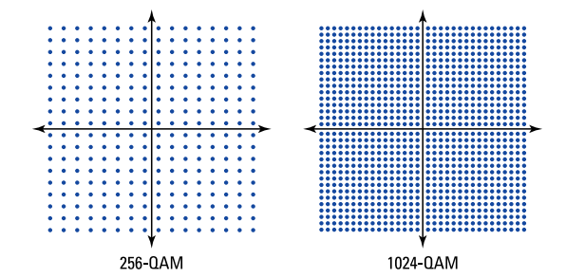
1024-QAM
A comparison of constellation charts between 256-QAM and 1024-QAM modulation is shown in the figure.
1024-QAM has many more constellation points.

Slide 61
1024-QAM
Error vector magnitude (EVM) is a measure which is used for quantifying the performance of a radio receiver or transmitter with respect to modulation accuracy.
With QAM modulation, EVM is a measure that provides the distance of a received signal from a constellation point.
Strong EVM is needed 802.11ax radios that are using 1024-QAM and sensitivity capabilities are also received.
(contd...)

Slide 62
Thanks

Slide 63
802.11ax Enhancements and Design Considerations II

Slide 64
New PHY Headers
A physical (PHY) header is added to all 802.11 frames in which a preamble and other information used for initial setup of communications between two radios has been contained.
The four new PHY headers are defined in the 802.11ax amendment to support high efficiency (HE) radio transmission, as follows:
HE SU
HE MU
(contd...)

Slide 65
New PHY Headers
HE ER SU
HE TB
The transmitting and receiving radios are synchronized by using the preamble and consists of two parts: legacy and high efficiency (HE).
The legacy stations (STAs) easily decode the legacy preamble and is included for backward compatibility.
(contd...)

Slide 66
New PHY Headers
The information between 802.11ax radios about OFDMA, MU-MIMO, BSS coloring, etc. is communicated by using the HE preamble components.
(contd...)

Slide 67
2.4 GHz is not Abandoned
Range
Installed base
Looking ahead
(contd...)

Slide 68
Design Considerations
Power over Ethernet (PoE)
MultiGig
Client devices
(contd...)

Slide 69
Thanks

Slide 70
Aerohive 802.11ax Family

Slide 71
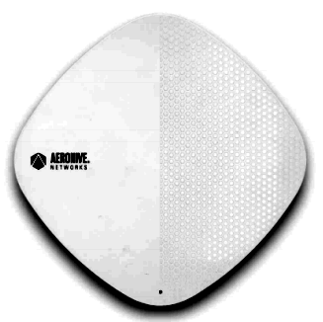
AP630
For high performance environments, the AP630 is designed in which the latest in Wi-Fi standards is combined with Aerohive’s HiveOS software and HiveManager network management system.
Internet of Things (IoT) readiness with built-in Bluetooth Low Energy (BLE) and Universal Serial Bus (USB) ports is enabled in AP630 as shown in the figure.

Slide 72
AP630
The AP630 is designed for:
High performance indoor environments
High client density environments
Voice over Wi-Fi
IoT applications
(contd...)

Slide 73
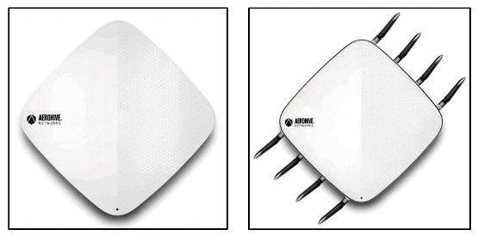
AP650 and AP650X
For high performance environments, the AP650 and AP650X are designed as shown in the figure.
They combine the latest in Wi-Fi standards, the latest in Ethernet standards, and Aerohive’s software-defined dual 5 GHz radios for indoor and industrial environments.

Slide 74
AP650 and AP650X
BLE and USB connectivity is integrated in the AP650 and 650X to enhance location-driven services and additional wireless access options are also added for IoT and other devices.
Superior flexibility, performance, and return on investment (ROI) is provided by dual 5 GHz 4x4:4 software-defined radios (SDRs) in the AP650 and AP650X compared to legacy access points with only a single 5 GHz radio.
(contd...)

Slide 75
AP650 and AP650X
AP650 is designed for:
High performance indoor environments
Very high client density environments
VoWiFi
IoT applications
(contd...)

Slide 76
AP650 and AP650X
AP650X is designed for:
Industrial deployments like warehouses
Lecture halls or auditorium-like environments
(contd...)

Slide 77
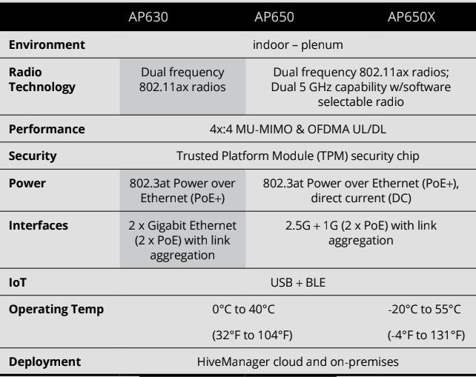
A Comparison of Aerohive’s 802.11ax Family

Slide 78
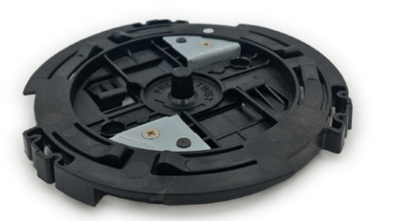
Aerohive 802.11ax Family
A new twist mount bracket is featured in the Aerohive’s family of 802.11ax access points which is designed to radically simplify installation as shown in the figure.

Slide 79
Thanks

Slide 80
Miscellaneous

Slide 81
Things to Know About 802.11ax
It’s a Wi-Fi paradigm shift.
The standard isn’t yet finalized.
No need to rip-and-replace the existing Wi-Fi installations.
Look forward to a little backward compatibility.
The smarthome is a high-density Wi-Fi environment.
(contd...)

Slide 82
Things to Know About 802.11ax
RU ready for simultaneous multi-user Wi-Fi access.
MU-MIMO enhancements are coming.
No more OBSSessing over spatial reuse.
No qualms about higher data speeds either.
Wi-Fi security will be better.
(contd...)

Slide 83
Thanks

