Slide 1
4G-LTE Technology Webinar

Slide 2
4G Technology

Slide 3
4G Technology
It is the fourth generation of broadband cellular network technology .
A 4G system must provide capabilities defined by ITU in IMT Advanced.

Slide 4
IMT - Advanced requirements
It should be based on all-IP packet switched network.
Peak data rates of approx. 100 mbps for high mobility and 1gbps for local wireless access.
Use scalable channel bandwidths of 5-20 MHz , optionally upto 40 MHz.
Have peak link spectral efficiency of 15 bits/sec.
Smooth handovers across heterogenous networks.

Slide 5
IMT - Advanced requirements
High QoS
Interoperability with existing wireless standards
Seamless connectivity and global roaming

Slide 6
4G Technology key features
MIMO - to obtain ultra high spectral efficiency by means of spatial processing including multi-antenna and multi-user MIMO.
Frequency domain equalization
Frequency domain statistical multiplexing
Link adaptation
Mobile IP utilized for mobility
IP based femto cells

Slide 7
4G Frequency bands

Slide 8
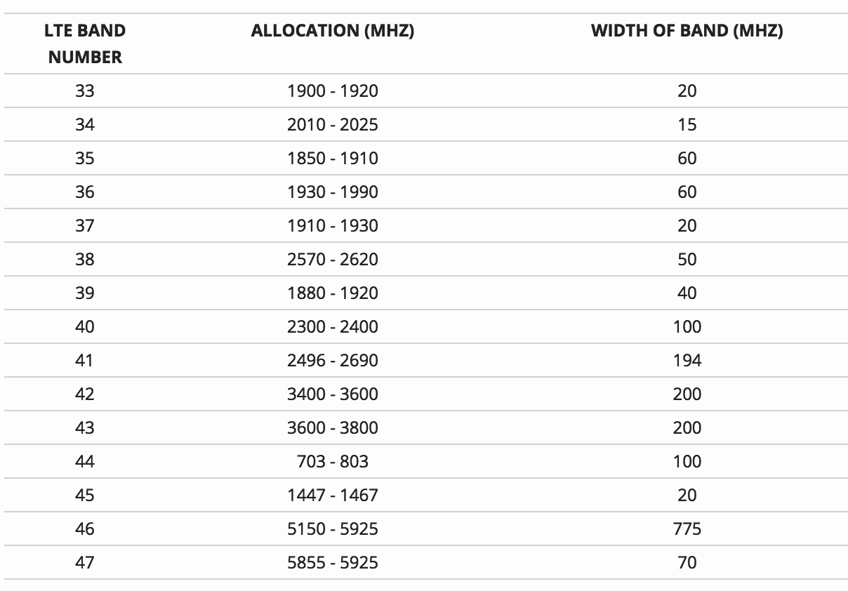
4G TDD Frequency bands

Slide 9
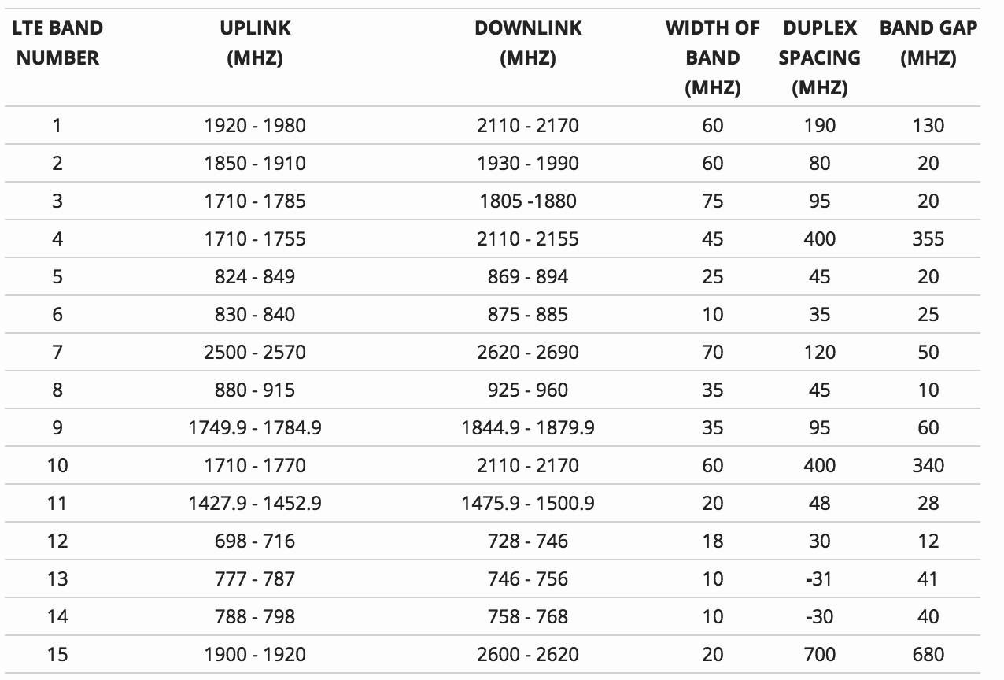
4G FDD Frequency bands

Slide 10
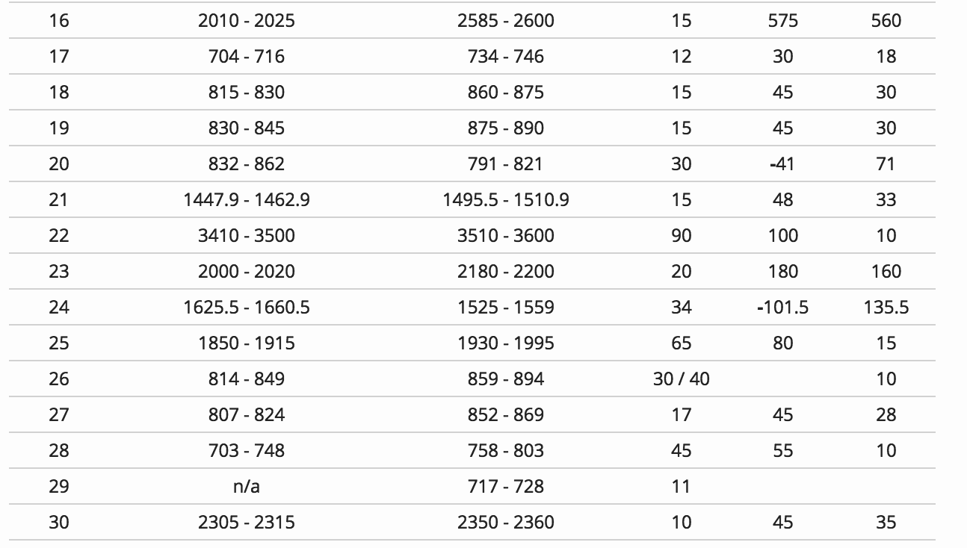
4G FDD Frequency bands

Slide 11
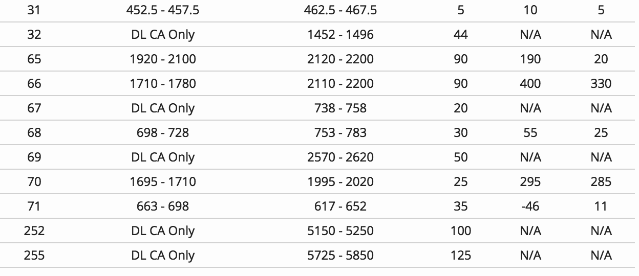
4G FDD Frequency bands
Notes:
bands 15 and 16 are now obsolete
DL CA Only refers to bands that are used for downlink carrier aggregation only
Bands 252 and 255 use the unlicensed spectrum and used with LTE-LAA / LTE-U.

Slide 12
Key enabling technologies

Slide 13
MIMO technology
MIMO ( multiple input multiple output) is a method for multiplying the capacity of a radio link using multiple transmitting and receiving antennas to exploit multipath propagation.

Slide 14
LTE MIMO modes
Single antenna
Transmit diversity
Open loop spatial multiplexing
Closed loop spatial multiplexing
Close loop with pre coding
MU-MIMO
Beamforming & MIMO

Slide 15
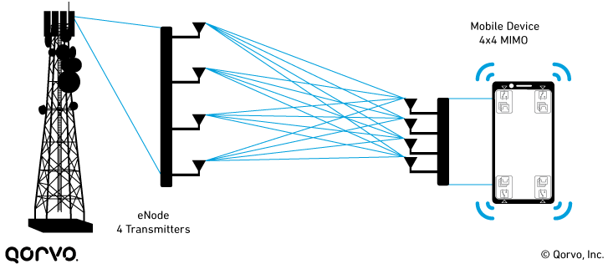
MIMO
Source: Qorvo

Slide 16
OFDMA
OFDMA is orthogonal frequency division multiple access.
It is a multi user version of of OFDM digital modulation scheme.
OFDM is a form of transmission that uses a large number of closely spaced carriers that are modulated with low rate data.

Slide 17
OFDMA
These signals would be expected to interfere with each other, but by making the signals orthogonal to each other there is no interference.
This is achieved by having the carrier spacing equal to the reciprocal of the symbol period.

Slide 18
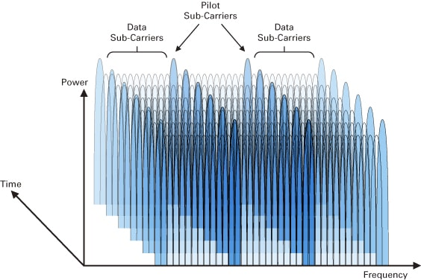
OFDMA

Slide 19
SC-FDMA
It is a frequency division multiple access scheme.
SC-FDMA can be interpreted as a linearly precoded OFDM scheme, in the sense that it has an additional DFT processing step preceding the conventional OFDM processing.

Slide 20
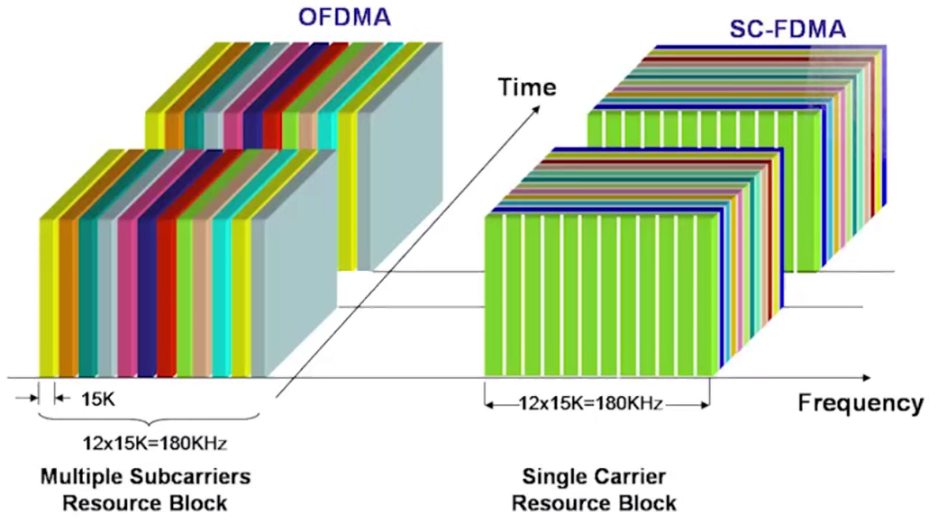
OFDMA v/s SC-FDMA

Slide 21
LTE Bandwidth
The bandwidths defined by the standard are 1.4, 3, 5, 10, 15, and 20 MHz.
Bandwidth (MHz) | Resource Blocks
1.4 | 6
3 | 13
5 | 25
10 | 50
15 | 75
20 | 100

Slide 22
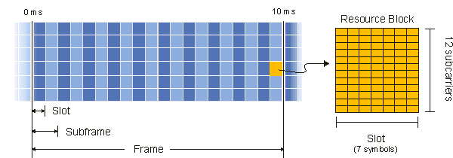
LTE Resource block
It is the smallest unit of resources that can be allocated to the user.
LTE FDD FRAME

Slide 23
4G Network Architecture

Slide 24
4G Network Architecture
The high level network architecture of LTE is comprised of three main components :
The user equipment
E-UTRAN
EPC

Slide 25
4G Network Architecture
Servers PDNs
EUTRAN
EPC
UE
Uu
S1
SGi

Slide 26
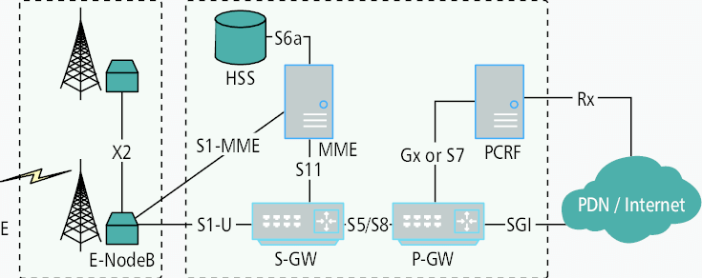
4G Network Architecture
UE
EUTRAN
EPC

Slide 27
The User equipment
The mobile equipment comprised of modules as :
Mobile Termination : this handles all the communication functions.
Terminal equipment : this terminates the data streams
UICC - universal integrated circuit card

Slide 28
E-UTRAN
The E-UTRAN handles the radio communications between the mobile and EPC and has one component , the evolved based stations, eNB (eNodeB)
eNB is a base station that controls the mobiles in one or more cells.

Slide 29
eNB functions
The eNB sends and receives radio transmissions to all the mobiles using analogue and DSP functions of air interface.
The eNB controls the low level operation of all its mobiles, by sending them signalling messages such as handover commands.

Slide 30
EPC functions
It is a framework of providing converged voice and video on a LTE network.
Key components of EPC include : MME, HSS, S-GW, P-GW, PCRF.

Slide 31
MME
It is the main signalling node in the EPC.
It is responsible for initiating paging and authentication of mobile device.
MME retains location information at the tracking area level for each user and then selects the appropriate gateway during initial registration process.

Slide 32
HSS
It is the concatenation of HLR and AUC.
It is responsible for user identification and addressing, user profile information management.

Slide 33
SGW
It serves as a local mobility anchor.
Packets are routed through this point for intra E-UTRAN mobility and mobility with other 3GPP technologies.

Slide 34
PGW
The PDN gateway is the termination point of the packet data interface towards the packet data network.

Slide 35
PCRF
PCRF server manages the service policy and sends QoS setting information for each user session and accounting rule information.

Slide 36
Differences between 4G and 3G

Slide 37
Differences
4G is the fourth generation of broadband cellular network technology which includes IP telephony, gaming , HD TV and video conferencing where as 3G supports voice telephony, mobile TV, video calls and web access.
4G offers data throughput of 100 - 300 mbps compared to 3G which offers between 0.5 - 1.5 mbps

Slide 38
Differences
4G offers peak upload rate of 500 mbps compared to 3G which offers 5 mbps.
4G offers peak download rate of 1 gbps compared to 3G which offers 100 mbps.
4G network architecture is based on integration of wireless LAN and wide area network whereas 3G network architecture is wide area cell based.

Slide 39
Differences
4G uses frequency bands of 2-8 GHz compared to 3G which uses 1.8-2.5 GHz.
4G is based on OFDM technology compared to 3G which is based on WCDMA technology.

Slide 40
Thanks
Check our 50+ Trainings & Certifications in 5G at www.telcomaglobal.com

